Slide 1
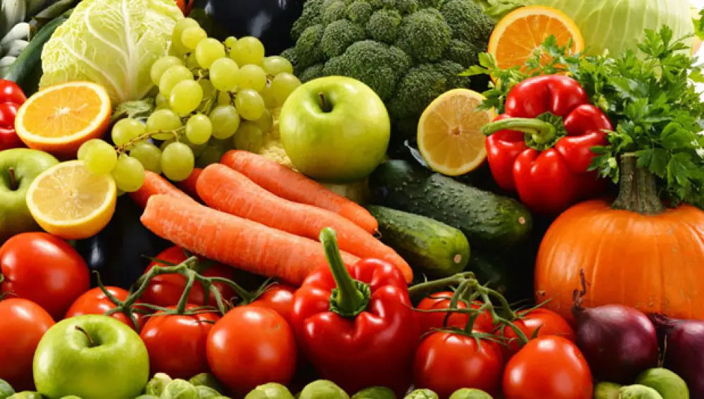
Thinking of an interesting business
Approach to making a correct decision on the location of a large business

Slide 2
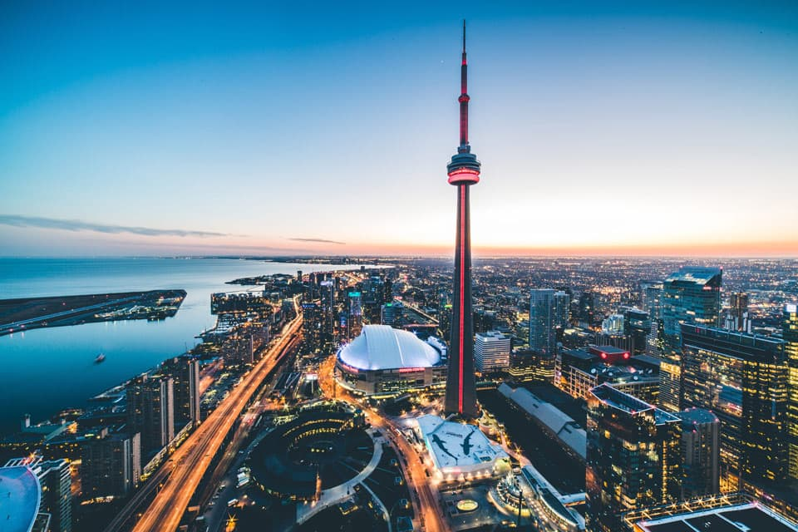
Background
Fruits and vegetables play an important role in a healthy diet.
Toronto is the capital of the province of Ontario and, with a population of 2,615,060 habitants and is the largest city in Canada in addition to the financial center of that country.

Slide 3
Problem
An investor dedicated to the creation of emerging businesses and with great knowledge in Entrepreneurship scalability tells me that you are interested in opening a point of sale for fresh vegetables.

Slide 4

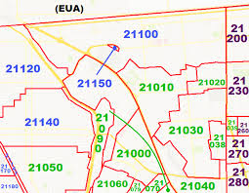
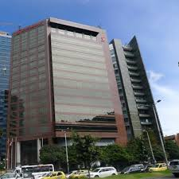
Data acquisition and cleaning

Slide 5
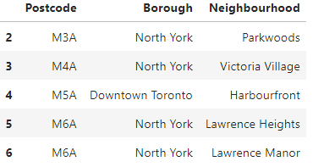
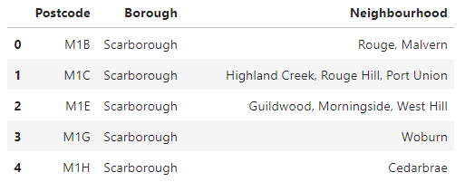
Data cleaning

Slide 6
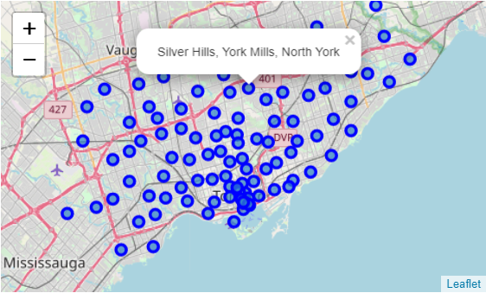
Plotting on a map of Toronto the neighborhoods found

Slide 7
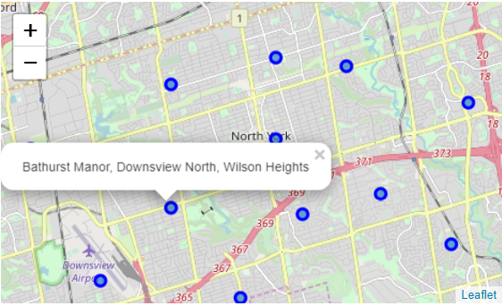
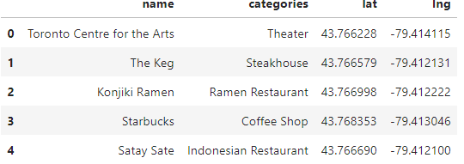
Selection
After conducting a review of all the neighborhoods that exist in Toronto and making a comparison with the information found in web searches, the Canadian Embassy and visual exploration (maps), North York was selected to search for neighborhoods and venues.

Slide 8
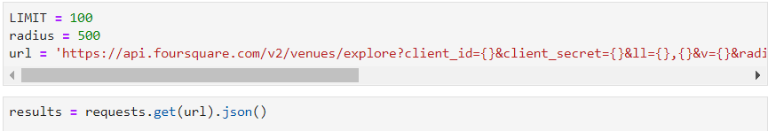
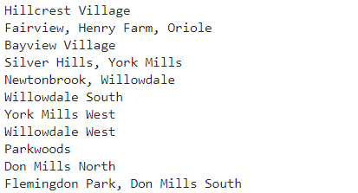
Using Foursquare
Foursquare is used to extract all venues from North York

Slide 9
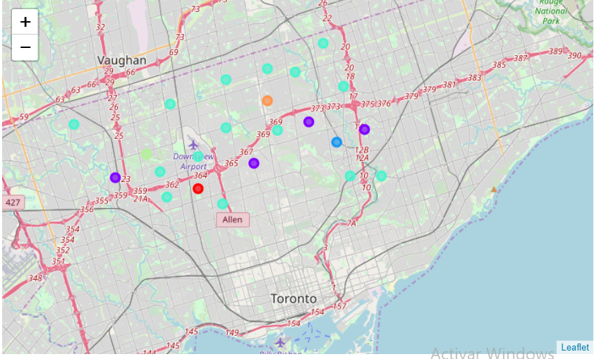
Applying one of Machine Learning Techniques (K-Means Clustering)
Here we cluster neighborhoods via K-means clustering method. We think that 6 clusters is enough and can cover the complexity of our problem.

Slide 10
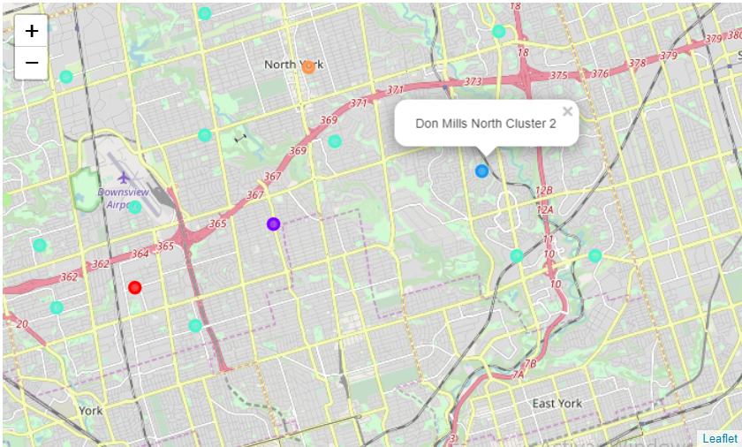
Conclusion
It is recommended that the investor search for and establish his fresh vegetable business in the Don Mills North neighborhood since the most common venue is Caribbean Restaurant and the others are related to healthy living, which is precisely what fresh vegetables give. The others are not recommended because they are mostly for sale or entertainment, which would not be a good place.

